Slide 1
Event and Fundraising Ideas

Slide 2
Purpose
Feel free to modify and adapt any of these ideas to fit YOUR County!
It is all about building relationships!
When you work hard, play hard
You must strike a balance to keep people involved
Social Events will bring individuals to the Party who might be intimidated to become involved through “political work”

Slide 3
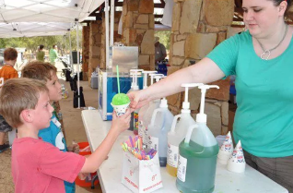
Event Ideas
Election Night Watch Party
Local restaurant or Voter’s home
Grand Old Picnic
Location: Local park
Event: Just a plain social with hot dogs, chips and coolers full of drinks
Ask local candidates, elected officials and conservative business owners for donations

Slide 4
Event Ideas
Lunch & Learn
Meet Dutch Treat at a local restaurant and have members speak on a variety of issues
Pizza & Politics
A very laid back, low cost and informal way to discuss issues
Coffee Club
A great way to allow for social interaction and does not require much planning

Slide 5
Event Ideas
Investiture of Precinct Chairs
Sample Agenda, Press Release and Certificate are included in your packet
Bumper Sticker/Sign Drops
Candidate literature
Yard signs & bumper stickers
Have drawings, prizes for kids, etc.

Slide 6
Events Ideas
Grand Opening of County Republican Headquarters
If you are opening a HQ even just for the Primary Election, host an event
Petition Signing Party
Either prior to the start of filing for office or before the filing deadline, invite rumored candidates and Republican voters to meet to allow candidates the opportunity to obtain signatures in lieu of paying the filing fee for office
Location
HQ
Republican Voter’s house
Local restaurant

Slide 7
Event Ideas
First Day of Filing
Host a filing party and contact current local officials, voters and media to assemble at a certain time on the first day of filing
Provides great exposure to candidates
Last Day of Filing
Upon the last day and close of filing host an event to announce and recognize all of the Republican candidates who have filed for office
Ballot Drawing
Invite all candidates, voters and media to attend the Ballot Draw
Candidate Forum
Before the Primary Election; if there is more than one Republican running for an office you MUST invite ALL Republican Candidates to participate

Slide 8
Fundrai$ing Idea$

Slide 9
Secret to Succe$$ful Fundraising?
You have to ask. . .
A lot of people for
A lot of money in
A lot of different ways
A lot of times
Then you have to do it again!

Slide 10
What motivates someone to give?
Issues
Emotions
Membership
Personalities
Donors will give if they are either really excited about what you are doing or really angry about what the Democrats are doing … so tell them!

Slide 11
Work backwards to your fundraising goal
Work backwards to your goal by asking yourself:
What are your resources?
How will you utilize them?
What does your county look like?
Wealthy or not?
Rural or urban?
WHO CARES IF REPUBLICANS WIN?
Do they have money?
What have other Republican campaigns/groups raised?
How did they raise that money?
Important to be realistic

Slide 12
Fundraising Advice
“First, call upon all of those you know will give something, next, apply to those you are uncertain whether they will give or not; and finally those who you are sure will give nothing, for in some of these you may be mistaken.”
-Benjamin Franklin

Slide 13
How to ask for money?!
You are going to hear, “No” … get over it!!!
Be direct!
Don’t say things like, “It would be
great if we could get your support.”
Instead say, “We need your support,
can I count on your contribution?”
State a purpose for the funds
ASK FOR THE MONEY!

Slide 14
How to ask for money?!
BE QUIET!
It is important to listen to their response and respond appropriately:
1. “Not that much” Negotiate
2. “Not ready” Call Back
3. “Need more info” Provide it
4. “No” Ask why

Slide 15
Direct Fundraising Ideas
Letters to potential donors
Known Party supporters
2 or 3 R voters
Donors for state-wide and lower Republican candidates on TEC reports
Learn from fundraising letters YOU receive
State your goal and purpose
Set a deadline for contributions
Offer a “match” from a generous donor if possible
Include several ways to donate
credit card, check (payable how), online, reply form with several suggested levels of giving.
Remind them how it will benefit them if you achieve your goal

Slide 16
How to get money in the mail!
Send a letter
Ask for money!
Follow up with a phone call
Ask for money!
MUCH higher cost of fundraising –
net revenue can be as low as
40% to 60%
What is your return on investment
(ROI)?

Slide 17
Components to a good letter
Letter is legal and includes all necessary disclaimers!
Carrier / Outer envelope
Should entice people to open your letter
Letter
Should be written at the 8th grade level
Easy to skim, with all of the monetary information bolded and key motivators underlined
Reply
Should be smaller than your letter and stand out within your package
Should also fit in your reply envelope
BRE – Business reply envelope
Have the correct return address
Fit in your carrier

Slide 18
How to get money online?!
Draft an e-mail
Ask for money!
Take advantage of everything you can in a timely manner
If you wait too long you lose money
Put an appeal on Facebook and Twitter
Are you set up for online contributions?
Where is the money being deposited
Are you collecting all of the information you need for compliance purposes
Have you considered and accounted for all of the costs associated with online fundraising

Slide 19
Direct Fundraising Ideas
Membership
Ask Republican voters to pay a ‘Membership Fee’ to help support the basic operations of the County Party.
Example: Member $15 or Family Membership $25
Make sure to keep these individuals informed of events and other important information.
You cannot force anyone to pay a fee to participate.
No one can ‘buy a vote’ on the CEC.

Slide 20
More Direct Fundraising Ideas
House Parties
Held in private home.
Host invites his/her friends, neighbors, co-workers, etc.
Host provides refreshments.
Party official presents possible power point.
Party official provides handouts with overview of presentation plus pledge and donation form.
Host also encourages attendees to donate.
Host provides contact information on attendees to Party for follow-up and helps with follow-up if possible.

Slide 21
More Direct Fundraising Ideas
Non-event “event”
No date conflicts
Catchy way to invite people to stay home from this event.
Don’t rent a tux, buy a dress or squeeze into those tight shoes. Don’t get a baby sitter. Don’t wash the car. Just stay home!
Bakeless Bake Sale
Ask for the amount the member would have spent if they had instead of gone to the store, baked for a few hours, and decorated, etc.

Slide 22
Direct Fundraising Partners
Grassroots PLUS
Partner with RPT to obtains ongoing, year-round donations.
Offer your own benefits to supporters as well as the RPT ones.
Special lapel pin, shirt, name recognition, etc.

Slide 23
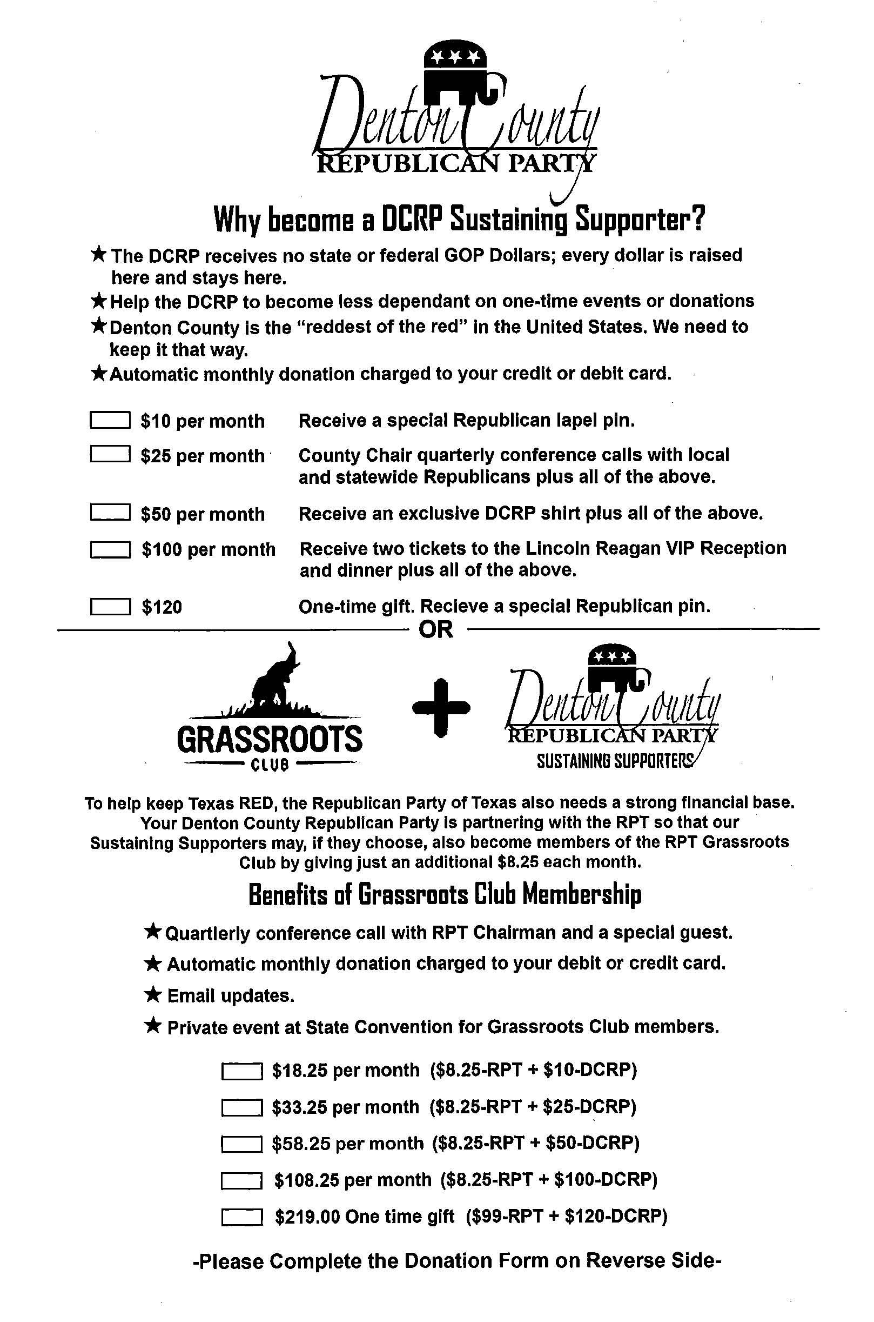
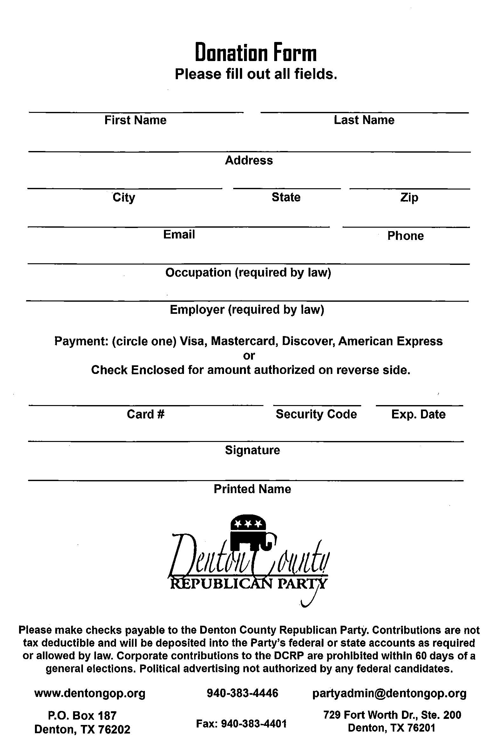

Slide 24
Other Fundraising Events
Golf Tournament
Underwriting is critical as it’s more difficult to get golfers to pay for a non-charity event.
Golfers will expect “swag”.
Include a silent auction of sports-related items.
May want to provide some “girly” event for wives in conjunction with golf, such as cosmetic and jewelry displays from vendors who will split proceeds with Party.

Slide 25
Dinners & Galas
Lincoln or Reagan Dinner
Dinner location
Speaker
Ticket sales
Auction items
Advertisement
Pink Elephant Gala
Everyone dresses in pink!
Cocktails & Dinner
Silent & Live Auction

Slide 26
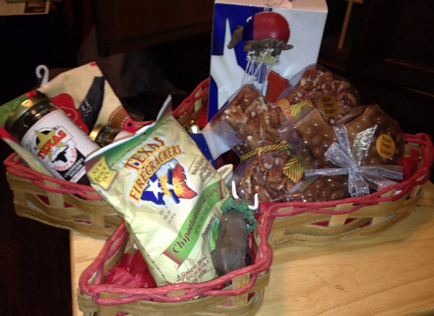
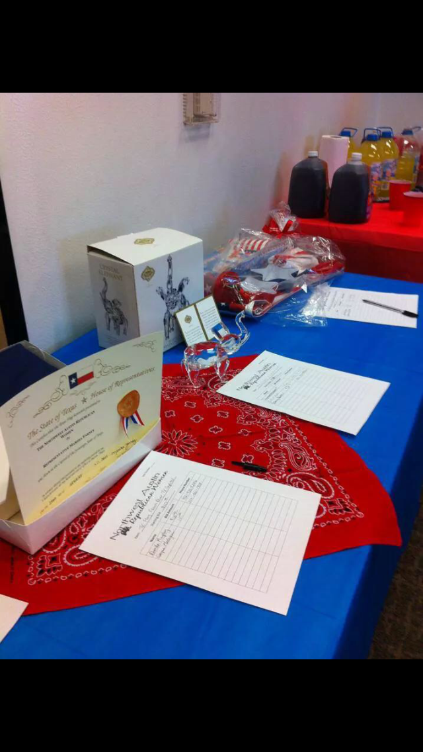
Suggestions for Auction Items
Flag to be flown over US or TX capital on date bidder specifies.
Special time with an elected official such as fishing trip, lunch, tour of capital, etc.
Year of monthly desserts by a fabulous cook in your county.
Prison-made items donated by legislators: rocking horse, special chairs, etc.
Political and sports memorabilia (“Auction in a Box.”)

Slide 27
Other Fundraising Events
Republican Round Up
Food, drinks and paper goods hopefully donated from local businesses.
Local Candidates
Serve food – Get to visit with voters as they pass through
the line.
Sell tickets – Each candidate is given a set of tickets to sell and then they are allowed to keep the funds from the tickets.
Tickets – Of course, you could sell the tickets with the funds coming back to the Party.

Slide 28
Other Fundraising Events
Themed Events
Lunch with YOUR LOCAL ELECTED OFFICIAL (a popular elected official) who may even donate the cost of the luncheon at a very nice place.
“Roast” an elected official
Perhaps one who is retiring or has just set a milestone in office.
Murder Mystery dinner (comedy)
Write your own with a “murdered” elected official or use a professional group.

Slide 29
Fundrai$ing Cautions
Raffle
Political Parties and Political Organizations CANNOT hold raffles as it is considered a form of gambling according to state law.
Plus the RPT Platform opposes gambling.
Silent and Live Auctions
Obtain donations from businesses, members and elected officials.
Sample sheets are in your packet for both Silent and Live Auction items to ensure that all Texas Ethics Commission requirements are met for both the donor, the purchaser and the item.

