Slide 1
GOP Data Center User Guide
Michael Burley
Data Director
Notes:
This template can be used as a starter file for presenting training materials in a group setting.
Sections
Sections can help to organize your slides or facilitate collaboration between multiple authors. On the Home tab under Slides, click Section, and then click Add Section.
Notes
Use the Notes pane for delivery notes or to provide additional details for the audience. You can see these notes in Presenter View during your presentation.
Keep in mind the font size (important for accessibility, visibility, videotaping, and online production)
Coordinated colors
Pay particular attention to the graphs, charts, and text boxes.
Consider that attendees will print in black and white or grayscale. Run a test print to make sure your colors work when printed in pure black and white and grayscale.
Graphics, tables, and graphs
Keep it simple: If possible, use consistent, non-distracting styles and colors.
Label all graphs and tables.

Slide 2
We will discuss..
Getting Access
Homescreen
Tools (Basic Counts & Find A Voter)
FAQ
Support
Notes:
Give a brief overview of the presentation. Describe the major focus of the presentation and why it is important.
Introduce each of the major topics.
To provide a road map for the audience, you can repeat this Overview slide throughout the presentation, highlighting the particular topic you will discuss next.

Slide 3
Getting Access to GOP Data Center
Every user will need to complete the GOP Data Center Access Request form, this must be fully completed and signed by an SREC member or your County Chair.
Candidates or persons working on behalf of a campaign must also complete the campaign agreement form.
Both forms can be found on the RPT website or requested by sending an email to gopdata@texasgop.org

Slide 4
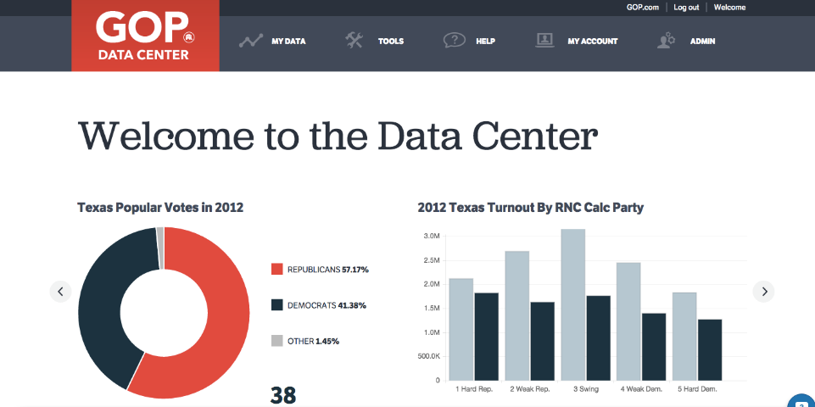
Home screen
Breakdown of the popular vote in 2012
Turnout by party in 2012
Notes:
New homescreen with election breakdowns for 2012.

Slide 5
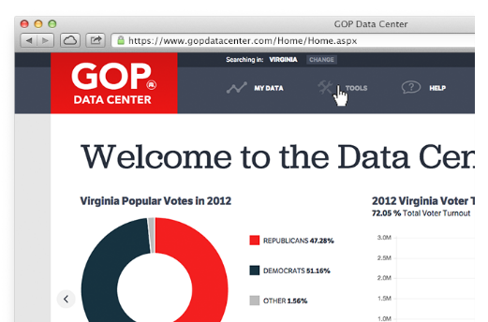
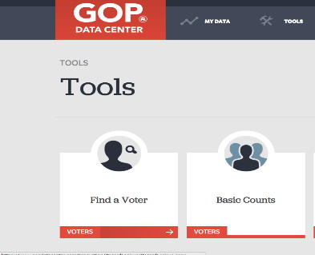
Navigate to Find a Voter
This feature is used to look up individual voters within your assigned area of access.
Click Tools in the main menu to navigate to the Find a Voter tool within the Tools page

Slide 6
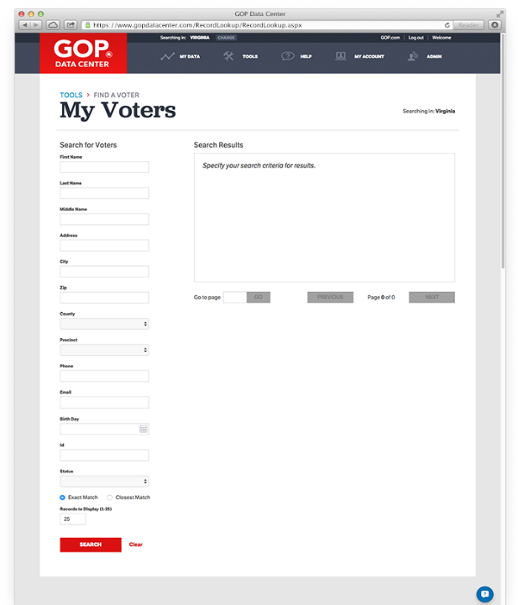
Using Voter Search
Voter records can be accessed using a variety of criteria including last name, first name, address, phone number, and county.
Search using either exact match or closest match functionality.
Notes:
This is another option for an overview slide.

Slide 7
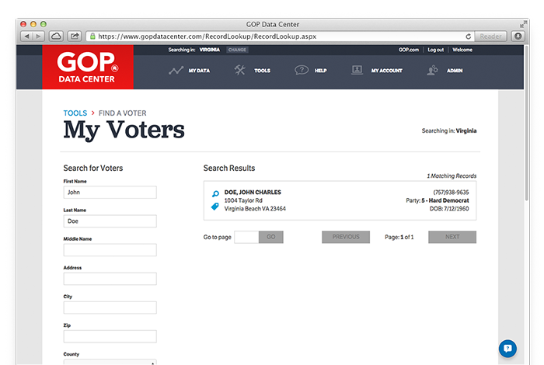
Voter Search Results
All voters that match your criteria will be displayed here.
View a voter’s details by clicking the magnifying glass.

Slide 8
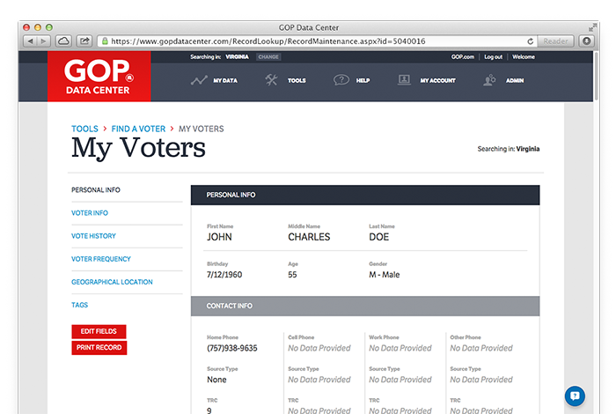
Viewing Voter Personal Information
The personal information includes the voter's name, birthdate, age, gender, phone number, party, and voter score
Users with certain site permissions will be able to modify certain aspects of the voter record including email, birthdate, gender, phone number, party (in select states), and secondary address

Slide 9
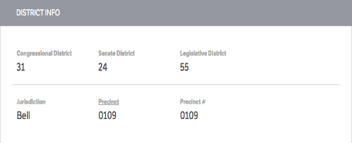
Voting Information
Observed Party is based on a hard ID, like a phone call or door knock
Calculated partisanship using partisan primary vote history and observations
The voter information tab includes the voter's registration status, registration date, observed party, and RNC calculated party
The District Information displays all of the political geography associated with a voter

Slide 10
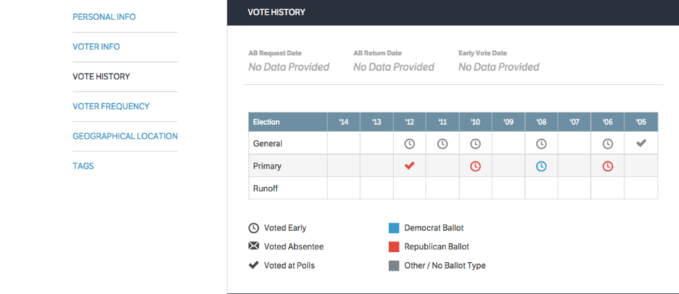
Voting History
In this example you can see that the person voted early in the general election in ‘12, ’11, ‘10, ‘08, & ’06 and voted at the polls in the ‘05 general.
You can also see that this person voted in the ‘06, ‘10, & ‘12 Republican primary & the Democratic primary in ‘08.

Slide 11
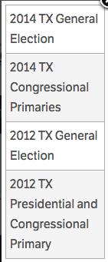
Voting Frequency
The voter frequency score is a method of looking at how turnout has been for the particular voter over the past 4 elections.
In Texas the following elections are taken into consideration to calculate the overall voter frequency score:

Slide 12
Navigating to Basic Counts
Click on the Tools Menu
Click on Basic Counts

Slide 13
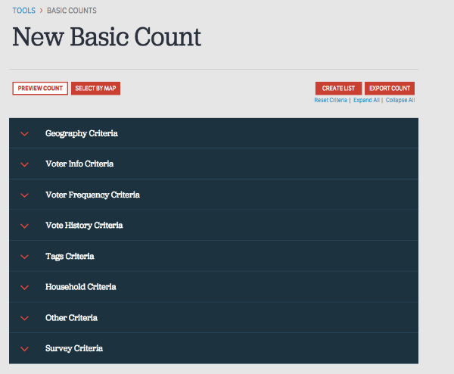
Using Basic Counts
This is where you will be able to pull lists of voters in specific geographical areas based on various data points of your choosing. Click a menu to expand and view options.
Examples for Using Basic Counts:
Creating a precinct walk/call list
Pulling a list of all “Hard R” voters in your precinct, county, etc.
Creating an invite list for an event in your county
All search criteria are based on “AND” logic, this means that your results will include voters that match all of the criteria you select.

Slide 14
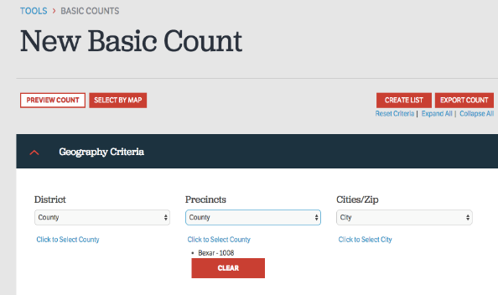
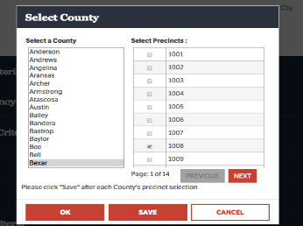
Selecting Criteria For Your Search – Geography
You are able to search by many different geographical areas, click on the link, check the box next to the desired district and select Save and OK. (NOTE: You can only select from one of the three headings: District, Precincts or Cities/Zip. If you select from more than one it will not give you a count.)
Use when searching for all voters in a county, SD, LD, etc.
Use to search by precinct level within a county, CD, LD, SD.
Use when searching by city or zip
Most of the time you will be searching by precinct within your county, make sure to always click SAVE and OK so your selection will show up in the search.
Notes:
These slides will go through all the data points that can be used to pull lists of voters. Note that for your audience they will most commonly be searching by precincts within their county.

Slide 15
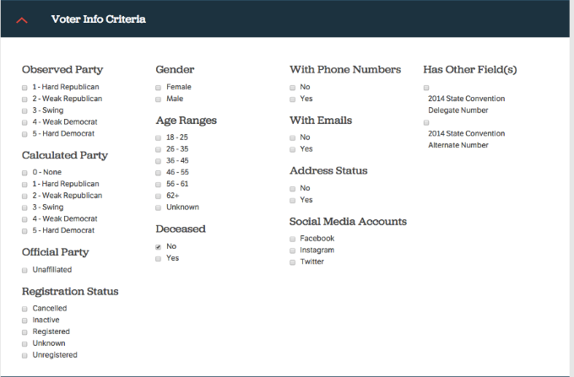
Selecting Criteria For Your Search- Voter Info
Check the box next to each criteria in order to include them in your count.
Keep in mind that if you do not select any box under a category your count will include all voters.
Recall the definitions for “Observed Party” and “Calculated Party” that we covered on slide #9.

Slide 16
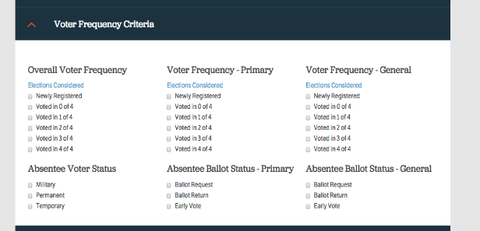
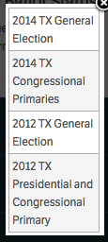
Selecting Criteria For Your Search- Voter Frequency
Voter Scores are generated by calculating voting participation based on the four previous elections.
Clicking the Elections Considered link will generate a report of which elections were used in the voter score calculation. In Texas we use these to calculate the Overall Voter Frequency Score:

Slide 17
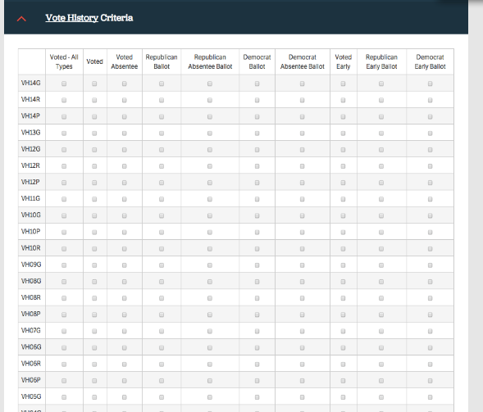
Selecting Criteria For Your Search- Voter History
The Vote History Criteria menu displays each election, a variety of vote methods and Partisan Primary data.
In order to capture all voters of a single election, select the "Voted All Types" check box.
The available election types are shown below, along with their abbreviation that you will find in the Vote History section.
G - General
P - Primary
R - Runoff

Slide 18
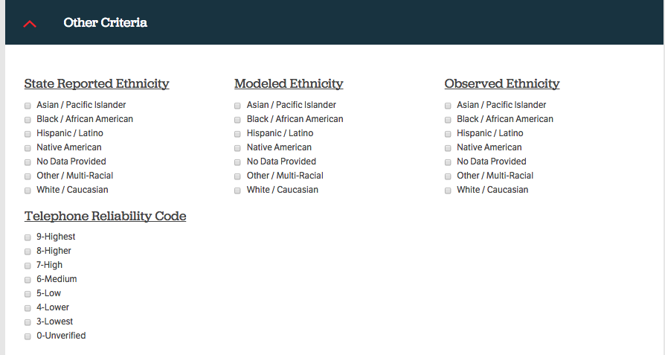
Selecting Criteria For your Search- Other
Telephone Reliability Code is assigned to every phone number and is used to as a measure the likelihood that the listed phone number belongs to the individual to which it has been assigned.

Slide 19
Contact Information
Please contact RPT Data Director Michael Burley at mburley@texasgop.org with any questions or concerns.
To GOP Data Center request access forms please contact gopdata@texasgop.org
Follow this link https://www.gopdatacenter.com/Innovation/Help/Videos.aspx for great help videos on GOP Data Center.

