Slide 1
Recruiting Precinct Chairs & Volunteers

Slide 2
Engagement
“Engagement” is not referring to one specific group of people – we need to engage everyone – do not pigeon hole people into groups
People are People
Engagement is Engagement

Slide 3
Start Where You Stand
Family, Friends, Co-workers and Neighbors
When you get on your soap box, who hops on with you?
Who shares your values?
Church Members
Co-workers
Republican groups in your area
“Coffee Club”
Who likes, comments, or shares your political Facebook posts?
Previous Republican candidates in your area

Slide 4
How to spot a Republican
PDA – Public Displays of Affiliation
Look for yard signs, stickers, statements, opinion letter in the newspaper
Displays political passions publicly
Facebook, Twitter, Instagram
Flags or outdoor decorations
Bumper stickers
Fishing or hunting gear

Slide 5
Recruiting
Recognize motivations
Issue based
Candidate based
Social interaction
Recruit Special Talents
Best way to motivate people is to give them a title and a task
If you don’t have a specific job for a volunteer ,create one
Not busy work, you want folks to feel they are making an impact
Best way to keep a volunteer is to appreciate them!

Slide 6
Invest & Connect
Ask questions!
“What issue are you most interested in or concerned/ passionate about?”
LISTEN to their answer
Do not interrupt!
Do not start formulating a response, just listen
This shows, through your actions, that you actually are them as a person not just a vote because you are investing your time
Take Action
Invite them to a meeting or social event
If at first you don’t succeed – try, try again!
Do not pressure or “blacklist” someone who turns you down – keep asking, but remember you want to leave them with a positive impression!

Slide 7
Keeping Volunteers
The BEST way to keep a volunteer is to appreciate them!
Say “thank you”
Be respectful of their time
Recognize their contribution
Build a personal relationship
We are in this to change hearts and minds – treat people like people
Remember something about them
Work just as hard as they do!
Never ask a volunteer to do something you are not also willing to do

Slide 8
Roles with your Area
Campaign Sign Depot
Register new Republicans in your area
Block Walk/Phone Bank
Walk to distribute party or campaign literature
Identify motivations of general election voters
Poll Watcher
Observe election and report any irregularities to the Election Judge or Clerk
Can serve for either the party or on behalf of a campaign
VOTER

Slide 9
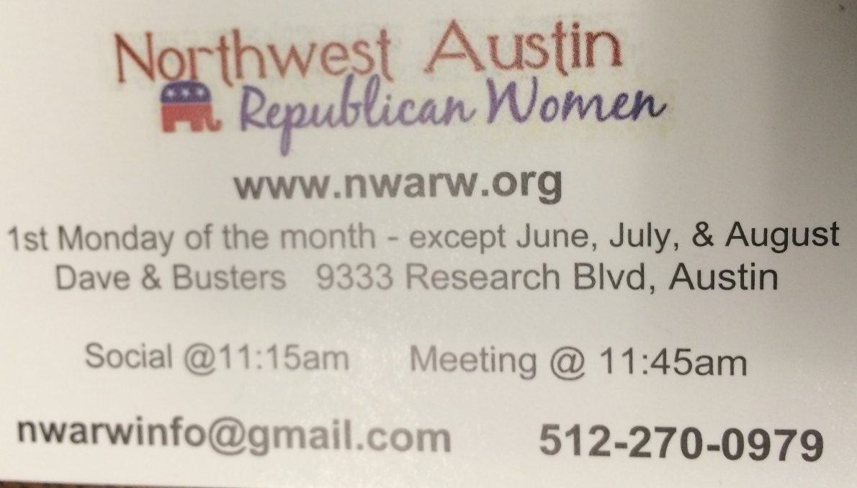
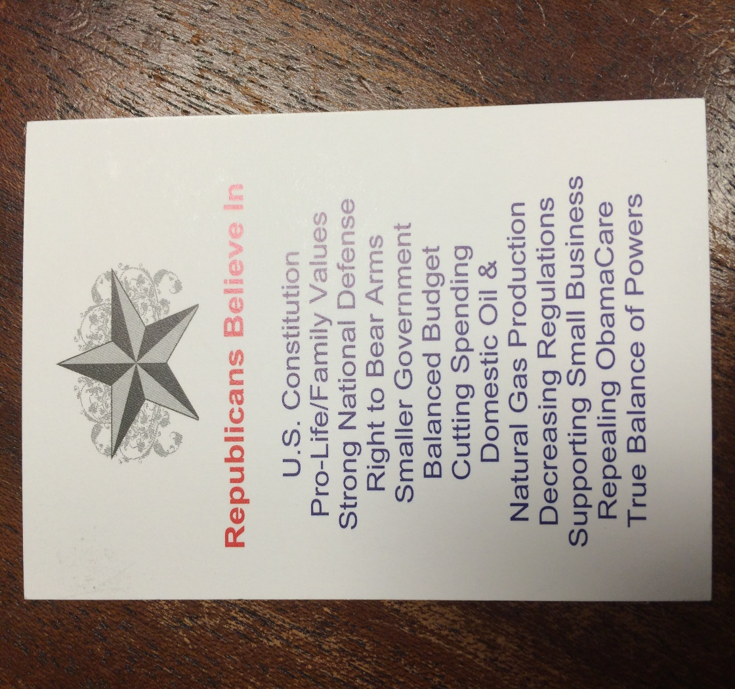
Make a Connection
Create your own push card
This double sided business card is easy to carry, cost effective and a proven tool!

Slide 10
Get Comfortable
Familiarize yourself with one or two facts about the 5 issues you are most interested in
This book has a small chapter on a wide range of topics from A – Z.
First it gives you the “Liberal Lie”
Then not only the “Conservative Comeback” but also facts to back it up!
Other groups will have similar “talking points”
Once you are informed and armed with facts you are automatically more confident, this will attract people!

Slide 11
Community Involvement
Get out of your comfort zone and show people
who Republicans are!
Chamber of Commerce
Excellent way to connect to a large
number of people
Mixture of social events
Learn about a variety of events
Business minded people tend to
lean politically to the right
Business Expo
Build and maintain connections
Share information about the party, events, and candidates

Slide 12
Community Involvement
Area Festivals
Provides a larger pool of voters that are not already involved
Excellent opportunity for candidates to help work the booths
Aids in flexibility for staffing the booth
If possible always have something to ‘give away’
Flier
Piece of candy
A piece of candy stapled to a flier
Drawing for $10 gift card
Everybody’s got something to celebrate!

Slide 13
Community Involvement
Local Civic Clubs
Many of these groups give back
to the community personally
instead of looking to government
to solve problems
It allows you to expand your
circle of influence to a
new group of voters

Slide 14
New Mover List
Voting history is compared against the US Postal Service national change of address list.
There are new residents in your county with Republican voting history, but are not yet registered to vote
Divide & Conquer
Assign sections of the list to local campaigns, precinct chairs, TFRW Club, and other volunteers
Fastest and easiest way to increase Republican votes in your county!

Slide 15
Remember!
There are no magic words, no special trick that mystically makes someone a Republican!
You are a living, breathing example of what a Republican is – your actions have an impact
Not just at political functions but all the time
Be confident and respectful, don’t let the stigma of “politics” keep you from engaging people
Invest yourself in the relationship, care about the PERSON not just the vote

Slide 16
Precinct Chairs 101

Slide 17
Precinct Chairs
Must be a registered voter in the precinct in which they wish to represent
File for Office
Elected by vote on the Republican Primary Election Ballot
Serve a 2 year term

Slide 18
Primary Election Ballot
The Secretary of State (SOS) allows that if only one person has filed to run for Precinct Chair, that person is declared elected and will not appear on the ballot
The name of the Precinct Chair elected in this manner must be posted by the Election Judge at the polling site

Slide 19
Filling a Precinct Chair Vacancy
County Executive Committees (CEC), which are comprised of the County Chair and Precinct Chairs, may appoint a registered voter in the precinct to fill the position of Precinct Chair if a vacancy occurs
Some large or mid-sized counties have a separate committee to vet candidates who wish to serve
The County Chair may appoint if there is not a CEC

Slide 20
Tips for Vetting Candidates to Fill a Vacancy
Check for past voting history or support of local candidates
Ask questions like
How did they learn about the vacancy?
Why do you want to be appointed Precinct Chair?
Will you be able to attend Precinct Chair training and other CEC meetings to help conduct the County Party’s business and represent your precinct?

Slide 21
Precinct Chair
You are the political Leader of your precinct!
#1 goal is to maximize the Republican vote in your precinct

Slide 22
Duties within your Precinct
Identify Voters
Register Voters
Pass out voter registration cards
Become a Deputy Voter Registrar
Inform Voters
About election dates and polling locations
Republican Nominees
Ballot Initiatives
Turn out Voters during elections

Slide 23
Duties within the County Party
Participate in CEC Meetings
Serve as a Officer, Committee Chair or Committee Member
Recruit Precinct Chairs & Volunteers
Help work precincts without Precinct Chairs
Assist your County Chair as needed

Slide 24
Duties within the Convention Process
Precinct Conventions
Temporary Chair
Turn in Precinct Convention paperwork to County Chair
Delegates & Alternates elected
Adopted Resolutions
Minutes
County-SD Conventions
If elected as a Delegate, serve on a temporary committee
Volunteer
State Convention
If elected as a Delegate or Alternate, attend the convention
Volunteer

Slide 25
Growing the Party
No organizer is an island
More volunteers means more can be done
Vice Precinct Chair or Block Captains
Cannot vote for a Precinct Chair on the CEC
The Quality of your connections is as important as the Quantity!

Slide 26
Mikenley Heller
Republican Party of Texas
State Organization Director
mheller@texasgop.org
512-879-4053 – o
512-480-0709 – f

