Slide 1
County Party Structure

Slide 2
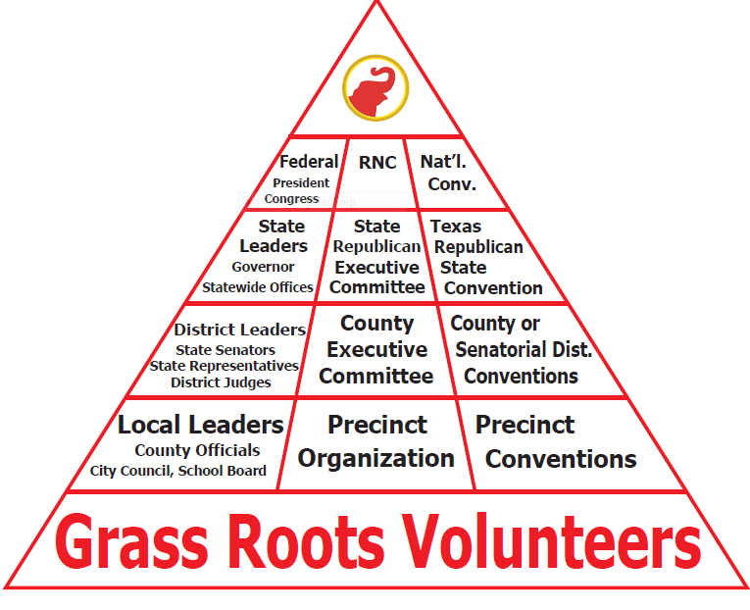

Slide 3
County Executive Committee (CEC)

Slide 4
County Executive Committee (CEC)
CEC Voting Members
The only VOTING members of the CEC when conducting official business required by the Texas Election Code
County Chair
Precinct Chairs
Non-Voting, Ex Officio
Officers and Committee Chairs who are not Precinct Chairs may serve as ex-officio (non-voting) members of the County Executive Committee.
Notes:
When filling vacancies, it is important to note that PROXY voting is not allowed. However voting by mail or email is, be sure you have confirmation that each seated Precinct Chairman received their ballot or call for votes.
Once the votes have been returned, send confirmation and be sure to keep on file.

Slide 5
County Executive Committee (CEC)
Terms of Office
All offices are 2-year terms and take office 20 days after the Primary Run-off Election
Outgoing County Chair has 30 days to transfer bank accounts and other related paperwork to the incoming County Chair
Failure to do so is a Class C Misdemeanor
Officers
Unless officers are ALSO Precinct Chairs, they are NOT counted in a quorum or allowed to vote (State Law)
Notes:
There is a common misconception that if someone holds a Precinct Chairmanship and no one files, the position carries over to the next term. The term of office ends after the two year period. One must file again or be elected by the newly elected CEC. The same applies to Party Officers.

Slide 6
County Chair

Slide 7
Role of the County Chair
Primary Election
Accept ballot applications for local candidates
Manage the Primary Election Funds
Convention
Hold Precinct & County/SD conventions
Elect Delegates to the RPT State Convention
Party Building
Recruit Precinct Chairs & Volunteers to help with events and outreach
Recruit local candidates to run for office
GOTV
Register voters
Turn voters out to vote!
Notes:
HANDOUT: County Chair Duties

Slide 8
Elections
Primary Election
Accept ballot applications from local candidates for the Republican Primary Election
Administer the Republican Primary Election
Manage Primary Election Funds
All Elections
Turnout voters to participate in elections
Submitting names for Election Judges and the Early Voting Ballot Board & Signature Verification Committee
Support ballot integrity
Appoint and approve poll watchers

Slide 9
Conventions
Precinct Conventions
Set Date & Secure Location
Provide Materials
County/SD Convention
Set Date & Secure Location
Organize, supervise, and encourage participation
Appointing committees
Submit delegates and alternates elected to serve at the State Convention
Submit resolutions to be considered by the Platform Committee at the State Convention
State Convention
Attend
Lead your County/SD delegation
Seat alternates as delegate as need arises
Assist to count votes

Slide 10
County Executive Committee
Recruit and provide training for Precinct Chairmen
Appoint officers and committees as needed
Call and preside over all County Executive Committee meetings
Ensure meetings are held at least quarterly
Maintain minutes of all meetings and a roster of all committee members
Notify RPT of any changes as they occur

Slide 11
Local Public Face of Republicans
Spokesperson to the local media
Answer questions
Issue press releases, newsletters or letters to the editor
Speak to groups and individual voters in your community about the work the County Republican Party is doing and how others may get involved
Keeping RPT Headquarters and SREC members informed of County Party activities

Slide 12
Manage & Build
Set up a headquarters
where possible and financially feasible
Resource for local elected officials and candidates
Help form Republican clubs where appropriate and work closely with those clubs
Promote a positive image of the Party through local media and by word of mouth
Maintaining rapport with community business, neighborhood, and civic groups
Welcoming newcomers to the area and having them register to vote

Slide 13
Precinct Chairs

Slide 14
Precinct Chairs
Must be a registered voter in the precinct in which they wish to represent
File for Office
Elected by vote on the Republican Primary Election
Serve a 2 year term
State law allows that if only one person has filed to run for Precinct Chair, that person is declared elected and will not appear on the ballot
The name must be posted by the Election Judge at the polling site

Slide 15
Precinct Chair Role in their CEC
Attend CEC Meetings
Serve on Committees
Help with Events
Volunteer
Set up, Work, & Tear down
Work the Polls
Election Judge
Poll Watcher
Post Candidate Signs at Polling Locations
Turn out Voters during elections
Assist in precincts without a chair
Assist County Chair as needed
Notes:
HANDOUT: Precinct Chair Duties

Slide 16
Precinct Chair Role in their Precinct
Identify Voters
Register Voters
Pass out voter registration cards
Become a Deputy Voter Registrar
Inform Voters
About election dates and polling locations
Republican Nominees
Ballot Initiatives
Precinct Convention
Turn out Voters during elections
Notes:
HANDOUT: Precinct Chair Duties

Slide 17
Precinct Chairs – Filling Vacancies
Two Requirements
Live in the Precinct
Be affiliated with the Republican Party
How to affiliate
Vote in the Primary or Runoff election
Take an oath of affiliation
The oath states that you HAVE NOT voted in the other Primary or participated in any of their conventions in the previous year.
If someone lives in the Precinct but voted in the
Democrat Primary or Runoff they are ineligible.
Notes:
There is a common misconception that if someone holds a Precinct Chairmanship and no one files, the position carries over to the next term. The term of office ends after the two year period. One must file again or be elected by the newly elected CEC. The same applies to Party Officers.

Slide 18
Filling a Precinct Chair Vacancy
County Executive Committees (CEC) may appoint a registered voter in the precinct to fill the position of Precinct Chair if a vacancy occurs
Some large or mid-sized counties have a separate committee to vet candidates who wish to serve
The County Chair may appoint if there is not a CEC

Slide 19
Removal of Precinct Chairs
Precinct Chairs (SB 1072)
Finally convicted of a felony
Affiliate with another political party
Voting in another party’s primary or runoff
Participate in another party’s convention process
Sign the Oath of Affiliation for a different political party
Ceases to be a resident of the precinct from which elected
Abandonment of Office (New Law)
After missing 4 or consecutive meetings the CEC may pass a resolution to instruct the County Chair to send a letter:
Stating the reason(s)
Sent by certified mail
Request a response not later than the 7th day after the date the precinct chair receives the notice.
If the Precinct Chair fails to respond the office becomes vacant
Took effect September 1st 2015

Slide 20
Importance of Precinct Chairs
Elected in the Primary
The absolute engine of the Party
Without a strong representation of your Precincts on the CEC, the Party can not serve the County and expand the voter base and turnout
Needed to keep and sustain Conservative growth
Notes:
There is a common misconception that if someone holds a Precinct Chairmanship and no one files, the position carries over to the next term. The term of office ends after the two year period. One must file again or be elected by the newly elected CEC. The same applies to Party Officers.

Slide 21
Republican Party of Texas Keep it Strong
Mikenley Heller
Republican Party of Texas
Director of Party Organization & Training
mheller@texasgop.org
512-879-4053 – o
817-773-7544 – c
512-480-0709 – f

